Slide 1
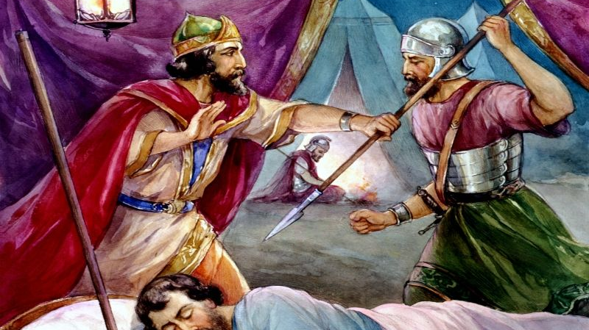
Killin’ Dave – part?
1 Samuel 26

Slide 2
DUPLICITY!
The picture.
Psalm 54:1-7 Save me, O God, by thy name, and judge me by thy strength. 2 Hear my prayer, O God; give ear to the words of my mouth. 3 For strangers are risen up against me, and oppressors seek after my soul: they have not set God before them. Selah. 4 Behold, God is mine helper: the Lord is with them that uphold my soul. 5 He shall reward evil unto mine enemies: cut them off in thy truth. 6 I will freely sacrifice unto thee: I will praise thy name, O LORD; for it is good. 7 For he hath delivered me out of all trouble: and mine eye hath seen his desire upon mine enemies.

Slide 3
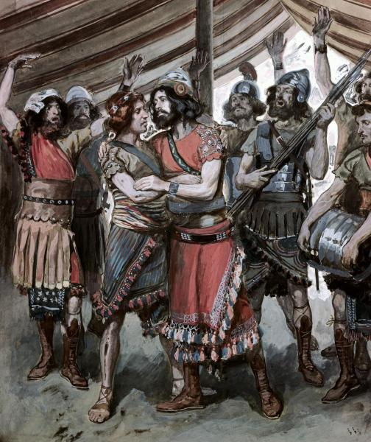

DUPLICITY!
Like Nabal, the Ziphites were of the tribe of Judah, they should have been loyal to David.
David was good to them, they returned the favor with betrayal.
Now it’s 3000 elite troops
against David’s 600. 5 against 1.
With God? Saul’s mercenaries are like sleeping babies.

Slide 4
Psalm 38:19-22 But mine enemies are lively, and they are strong: and they that hate me wrongfully are multiplied. 20 They also that render evil for good are mine adversaries; because I follow the thing that good is. 21 Forsake me not, O LORD: O my God, be not far from me. 22 Make haste to help me, O Lord my salvation.

Slide 5
Proverbs 26:11 As a dog returneth to his vomit, so a fool returneth to his folly.
KEY: Absent repentance,
nothing changes!

Slide 6
2 Corinthians 7:10-11 For godly sorrow worketh repentance to salvation not to be repented of: but the sorrow of the world worketh death. 11 For behold this selfsame thing, that ye sorrowed after a godly sort, what carefulness it wrought in you, yea, what clearing of yourselves, yea, what indignation, yea, what fear, yea, what vehement desire, yea, what zeal, yea, what revenge! In all things ye have approved yourselves to be clear in this matter.

Slide 7
Beware being full of anger and hate, you make yourself God’s enemy.

Slide 8
Romans 1:18 For the wrath of God is revealed from heaven against all ungodliness and unrighteousness of men, who hold the truth in unrighteousness;

Slide 9
Romans 1:29-32 Being filled with all unrighteousness, fornication, wickedness, covetousness, maliciousness; full of envy, murder, debate, deceit, malignity; whisperers, 30 Backbiters, haters of God, despiteful, proud, boasters, inventors of evil things, disobedient to parents, 31 Without understanding, covenantbreakers, without natural affection, implacable, unmerciful: 32 Who knowing the judgment of God, that they which commit such things are worthy of death, not only do the same, but have pleasure in them that do them.

Slide 10
1 John 3:15 Whosoever hateth his brother is a murderer: and ye know that no murderer hath eternal life abiding in him

Slide 11
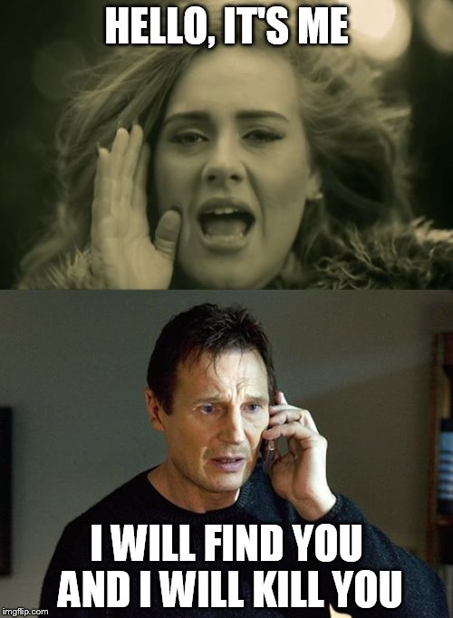
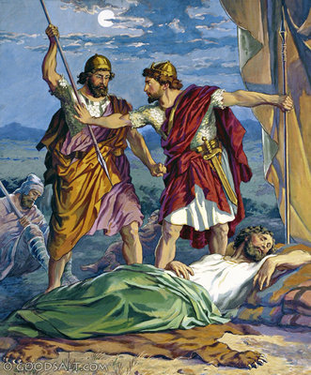
DARING!
David moved TOWARD the problem to deal with it.
James 4:7-8 Submit yourselves therefore to God. Resist the devil, and he will flee from you. 8 Draw nigh to God, and he will draw nigh to you.
Abishai was ready to kill.

Slide 12
Abishai looked at Saul and saw a wicked man that needed to be put down.
David saw God’s will. David saw the Lord’s anointed.

Slide 13
David is living by principle not feelings.
The principles of God’s Word do not change based on your changing circumstances or changing feelings!

Slide 14
1 Peter 2:17 Honour all men. Love the brotherhood. Fear God. Honour the king.
Romans 13:1 Let every soul be subject unto the higher powers. For there is no power but of God: the powers that be are ordained of God.
1 Timothy 5:1 Rebuke not an elder, but intreat him as a father; and the younger men as brethren;

Slide 15
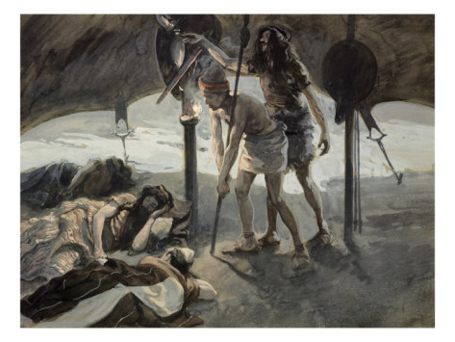

Slide 16
DARING!
God was doing the work! Without God, they could not have gotten close to Saul.
They were in the middle of an army of 3000 elite troops (vs 5)
– talking! And got away with it. Why? God.
David could face death because he knew God was with him! Ps 23

Slide 17
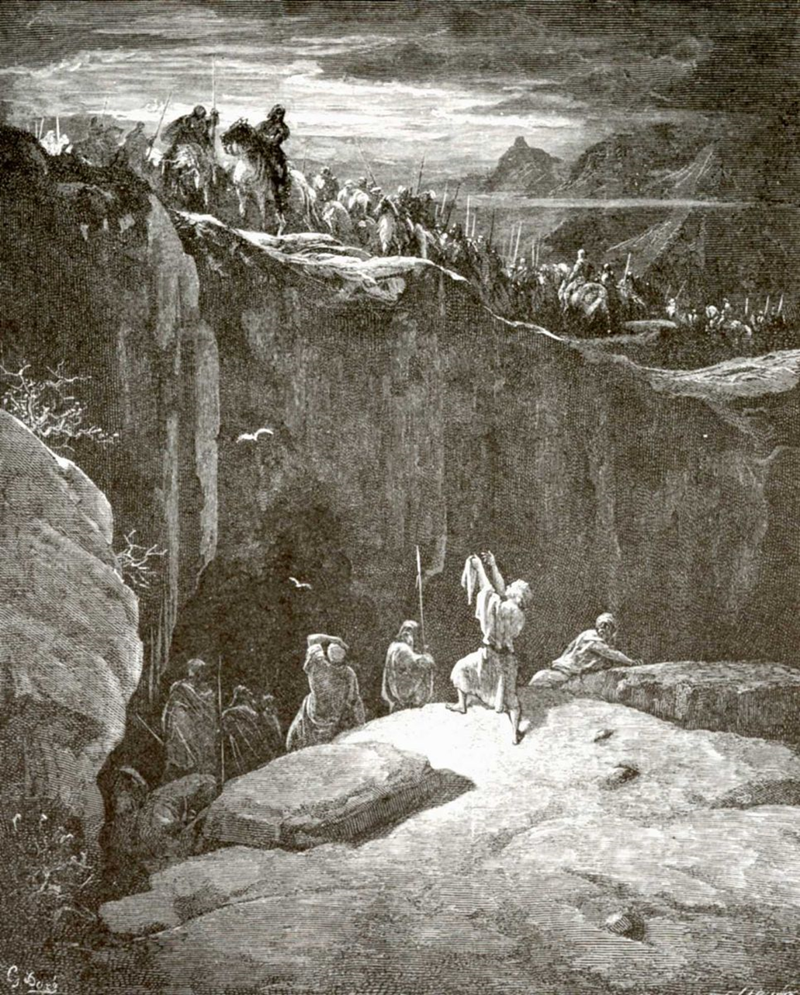

Slide 18

DERISION!
Dissin’ lil’ Abner
Abner took a nap when he should have kept watch!

Slide 19
1 Thessalonians 5:6 Therefore let us not sleep, as do others; but let us watch and be sober.
James 4:17 Therefore to him that knoweth to do good, and doeth it not, to him it is sin.

Slide 20

DERISION!
Dissin’ lil’ Abner
Abner took a nap when he should have kept watch!
KEY: Who are we serving? That answer should motivate us.

Slide 21
Hosea 10:2a Their heart is divided; now shall they be found faulty:
Colossians 3:23-25 And whatsoever ye do, do it heartily, as to the Lord, and not unto men; 24 Knowing that of the Lord ye shall receive the reward of the inheritance: for ye serve the Lord Christ. 25 But he that doeth wrong shall receive for the wrong which he hath done: and there is no respect of persons.

Slide 22

DISHONESTY!
Saul comes to truth when forced
David is getting over the betrayal.
If David was in sin before the LORD sacrifice could be offered BY LAW to atone!
Vs 21: This is the 3rd time Saul has said those exact words.

Slide 23
1 Samuel 19:6 And Saul hearkened unto the voice of Jonathan: and Saul sware, As the LORD liveth, he shall not be slain.

Slide 24
Vengeance is the Lord’s.

Slide 25
Romans 12:17-19 Recompense to no man evil for evil. Provide things honest in the sight of all men. 18 If it be possible, as much as lieth in you, live peaceably with all men. 19 Dearly beloved, avenge not yourselves, but rather give place unto wrath: for it is written, Vengeance is mine; I will repay, saith the Lord.
Hebrews 10:30 For we know him that hath said, Vengeance belongeth unto me, I will recompense, saith the Lord. And again, The Lord shall judge his people.
Proverbs 20:22 Say not thou, I will recompense evil; but wait on the LORD, and he shall save thee.

Slide 26
Luke 23:34 Then said Jesus, Father, forgive them; for they know not what they do. And they parted his raiment, and cast lots.
Luke 23:46 And when Jesus had cried with a loud voice, he said, Father, into thy hands I commend my spirit: and having said thus, he gave up the ghost.

Slide 27
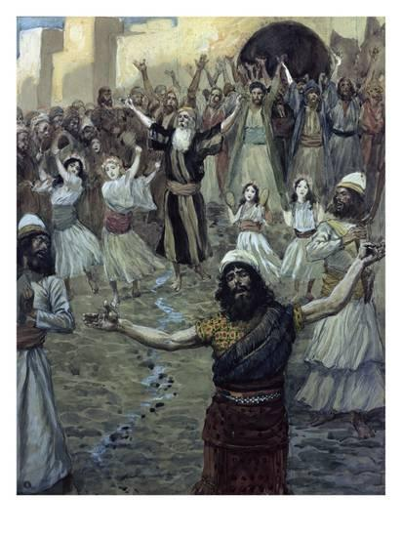
SAUL WAS AMONG THE PROPHETS

Slide 28
Saul a type of antichrist
“returned to his place”
Compare Judas.
Acts 1:25 That he may take part of this ministry and apostleship, from which Judas by transgression fell, that he might go to his own place.

Slide 29
Killin’ Dave – part?
1 Samuel 26

